Slide 1
A defect-based physics-informed machine learning framework for fatigue finite life prediction in additive manufacturing
Enrico Salvati, Alessandro Tognan, Luca Laurenti, Marco Pelegatti, Francesco De Bona
Jack Taylor & Waris Khan
02-18-25

Slide 2
Agenda
Overview of Topic (Introduction)
Materials and Methods
Results and Discussion
Suggestions and Improvements

Slide 3
1. Intro – Problem Overview
AM parts are prone to defects – pores, lack of fusion, micro cracks, etc.
Size
Shape
Location
Defects affect the fatigue/endurance characteristics
Fracture mechanics concepts
Statistical
Phenomenological
FEM based
Experimental
ML Techniques
SVM [1]
Random forest [2]
Assumptions & Simplifications
Predictive Model
Data Hungry
Notes:
Thermal gradient
Computationally expensive

Slide 4
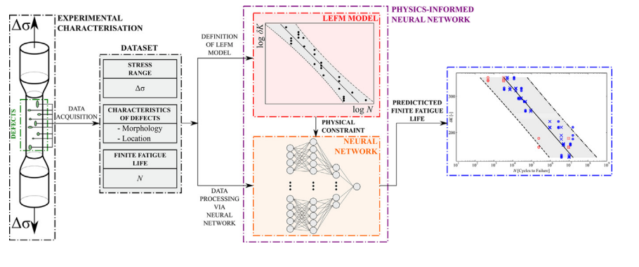
1. Intro – Problem Overview
Objective : Fatigue life prediction of AlSi10Mg alloy manufactured by selective laser melting using PINNs
Notes:
Thermal gradient

Slide 5
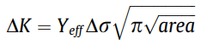
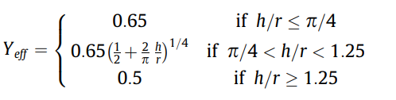
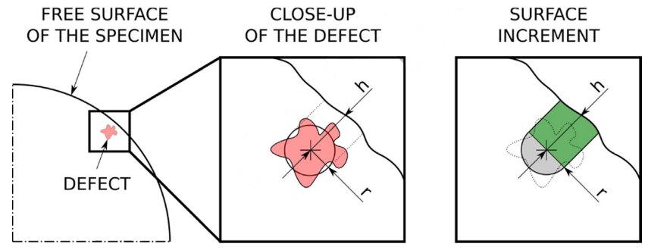
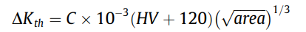
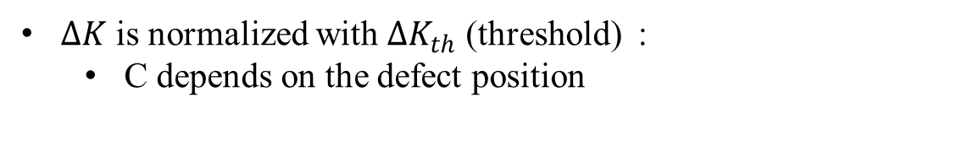
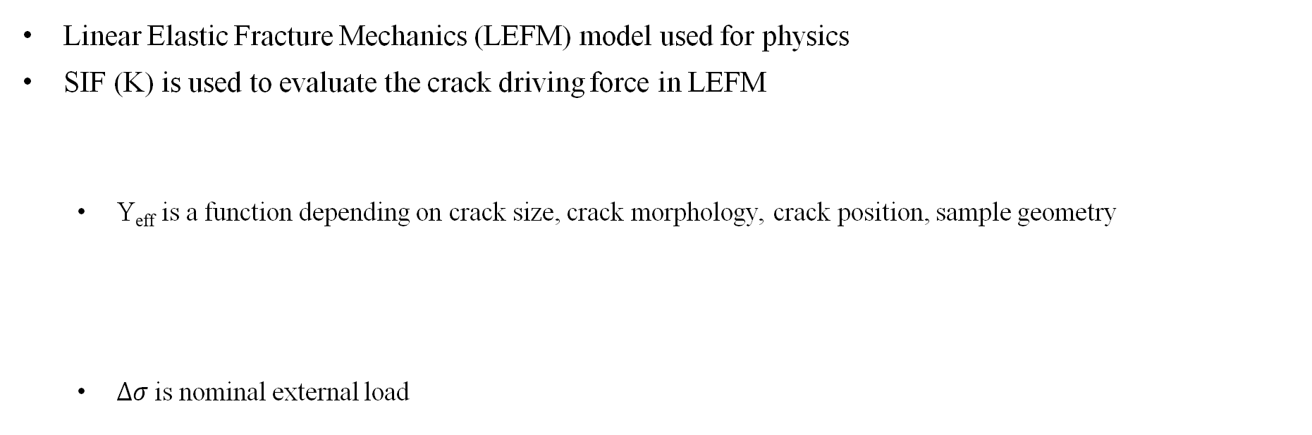
1. Intro – Linear Elastic Fracture Mechanics
Linear Elastic Fracture Mechanics (LEFM) model used for physics
SIF (K) is used to evaluate the crack driving force in LEFM
Y_{eff} is a function depending on crack size, crack morphology, crack position, sample geometry
$∆σ$ is nominal external load
$∆K$ is normalized with $∆K_{th}$ (threshold) :
C depends on the defect position

Slide 6
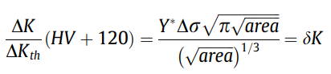
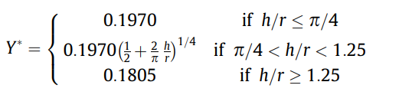
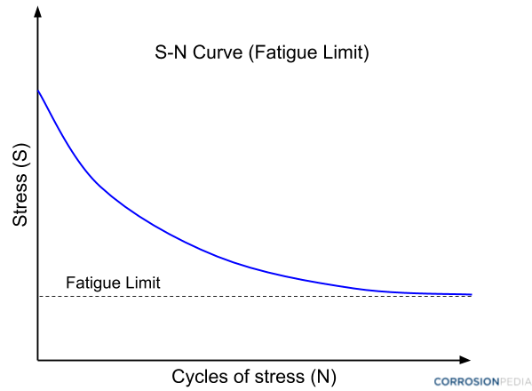
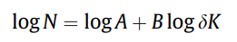
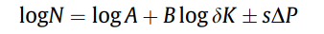
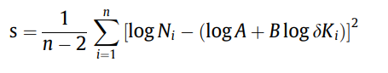
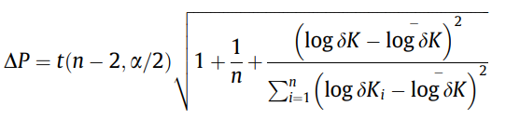
1. Intro – Linear Elastic Fracture Mechanics
Normalized SIF :
Fatigue predictions :
S-N curve equivalent $δK−N$
Predictive band :
Notes:
where t (n-2, α /2) is the a/2 quantile of the t-distribution with n -2 degrees of freedom
s is the square root of the estimator for the variance

Slide 7
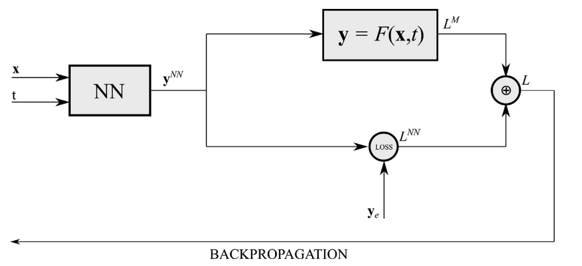
1. Intro – PINNs
NNs are black box and only data dependent
PINNs integrate physics knowledge (in the form of PDEs, ODEs, etc.) into neural network training
Inputs

Slide 8
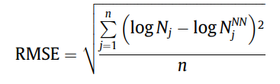
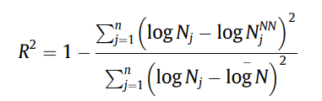
1. Intro – PINNs
Parameters indicating accuracy of PINNs:
Coefficient of Determination (R2) :
Notes:
idea of how much of the "story" your model is capturing about the data
How much variability is accounted for

Slide 9
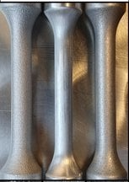
1. Intro – Samples
AlSi10Mg cylindrical sample
EOS M400 – SLM
Gauge volume (testing) – 4mm to 6mm
Layer thickness – 60μm
CT pre testing
Load ratio (R) = -1
Fractography – postmortem
Notes:
Over 3 years
Upgrade of some parts

Slide 10
2. Conceptual Representation of PINN
Physics Model Output and Loss
NN output
Inputs
Total Loss
NN Loss
‘Expected’ output from exp. Data

Slide 11
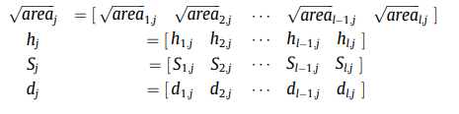
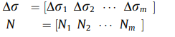
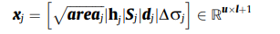
2. PINN – Model Inputs
For a data set of m samples (j = 1,2..m) where each sample contains l ‘killer’ defects:
Defect dependent inputs
6 folds cross validation
Sample dependent inputs
Full Input vector
Experimental solution vector

Slide 12
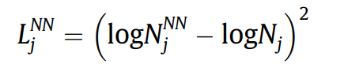
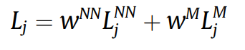
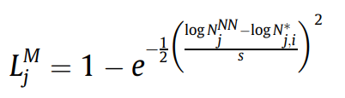
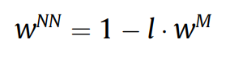
2. PINN – Loss Functions
The total loss function, L, is a weighted sum of L^{NN} and L^{M}:
- Where N^{NN} is the NN predicted out put and N is the experimental data
*Weights are arbitrarily selected and must sum to 1:
- Where N^{NN} is the NN predicted out put and N* output from the model regression fit

Slide 13
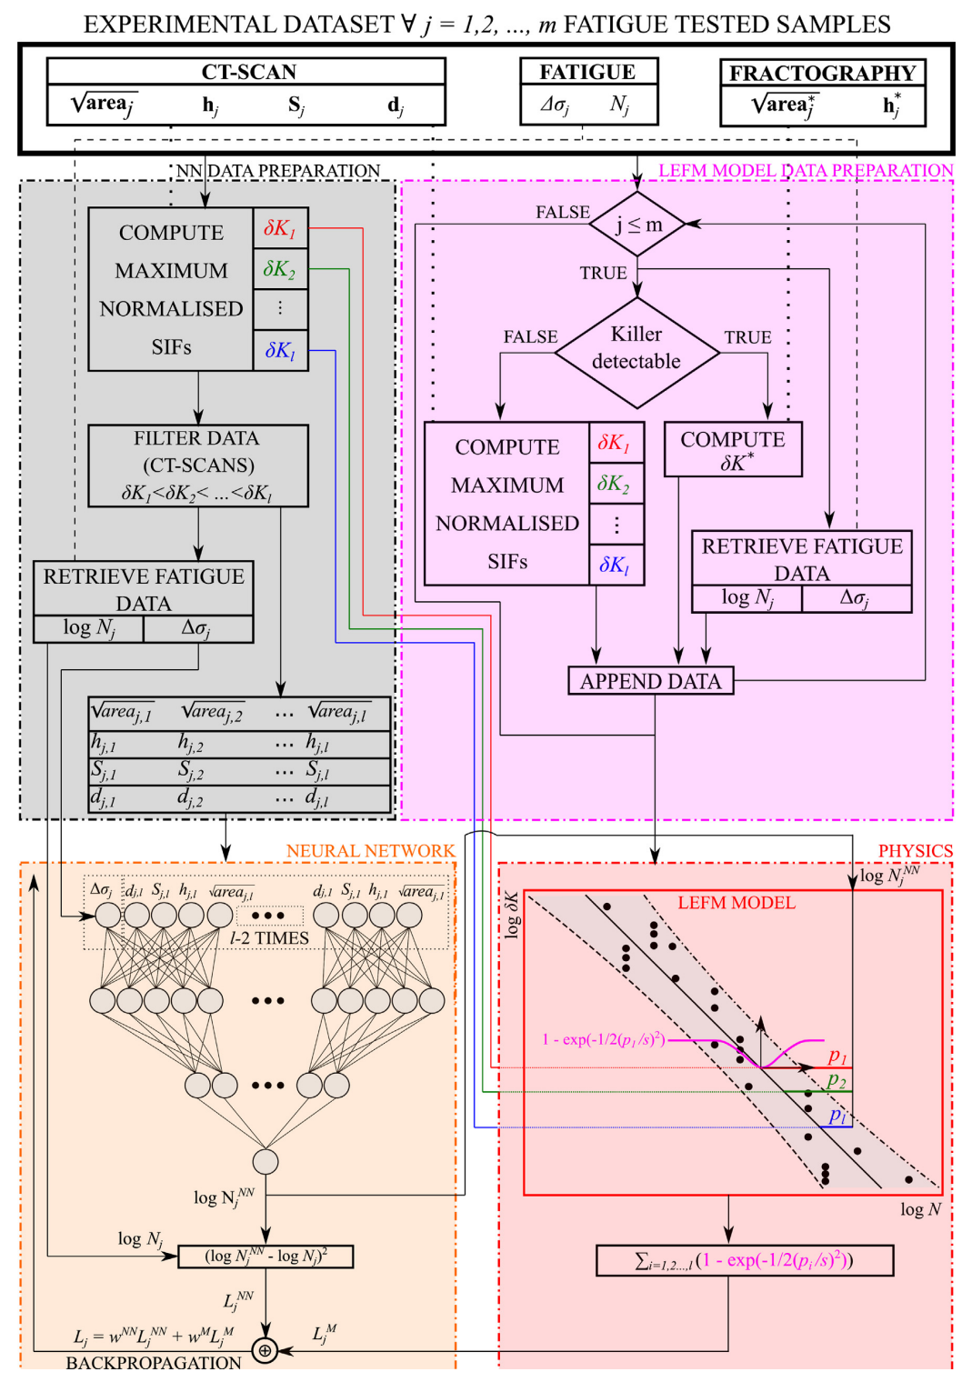
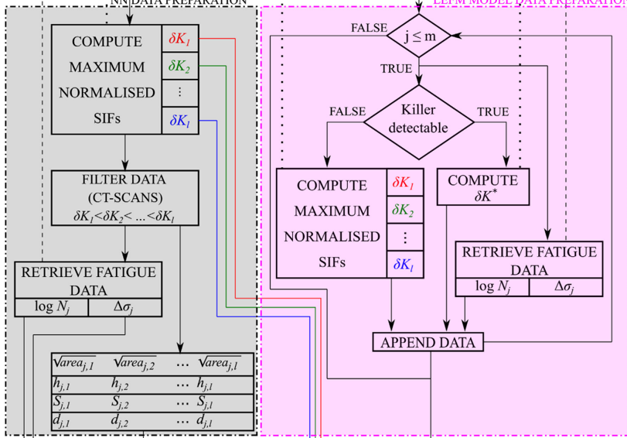
2. Problem Specific PINN Framework

Slide 14
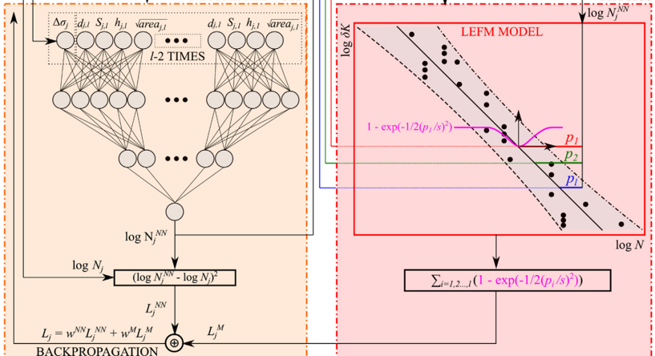
2. Problem Specific PINN Framework
13- element input layer (l = 3)
16-neuron hidden layer
8-neuron hidden layer
single-neuron output layer.

Slide 15
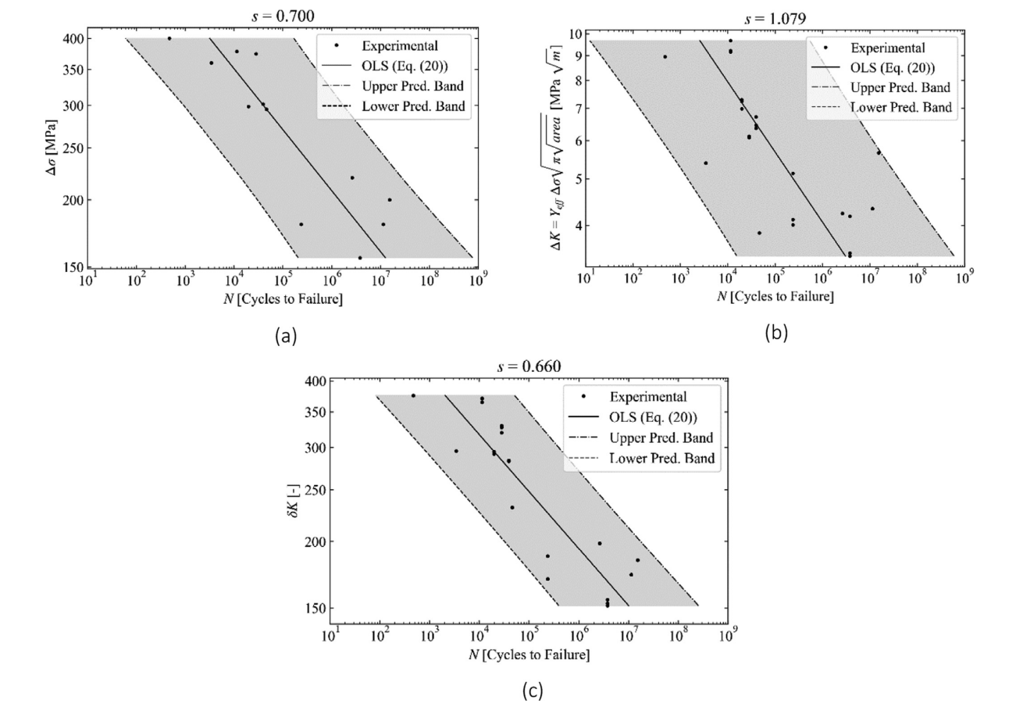
3. Results and Discussion – Normalization
Regression curves of fatigue life, prediction bands and square root of the estimator for the variance (s) at 95% confidence level. (a) $S−N$; (b) $∆K−N$; (c)$δK−N$

Slide 16
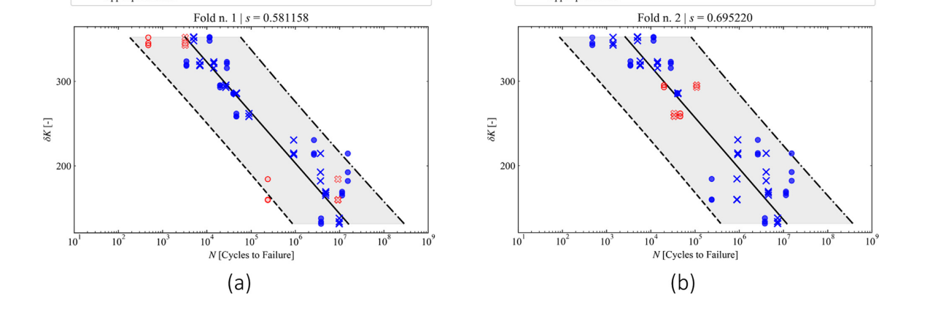
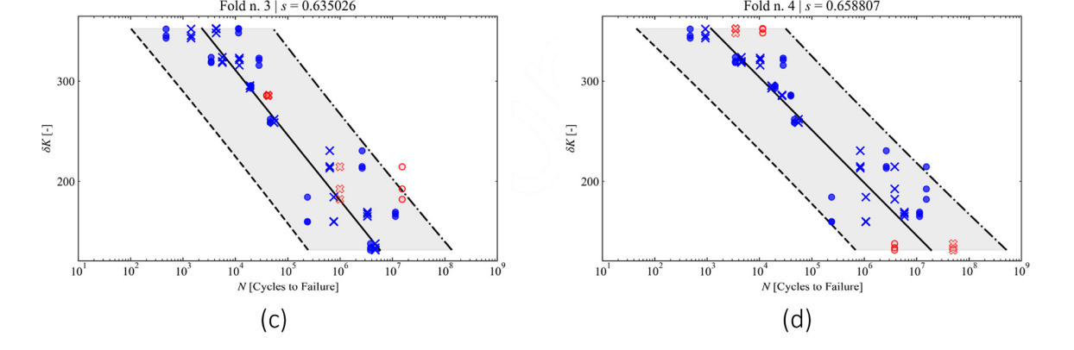
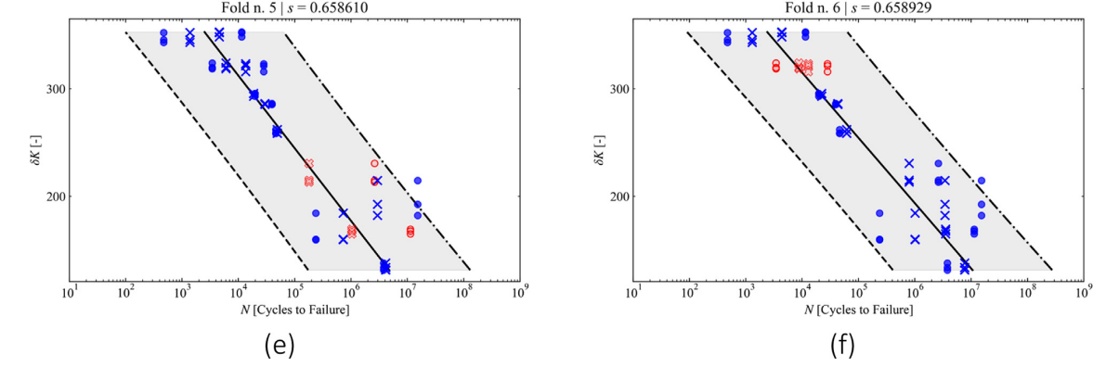
3. Results and Discussion
Predicted fatigue life overlapped onto the prediction band associated with the considered test samples. Different permutations between test and validations samples are shown (K-fold) (a-f)

Slide 17
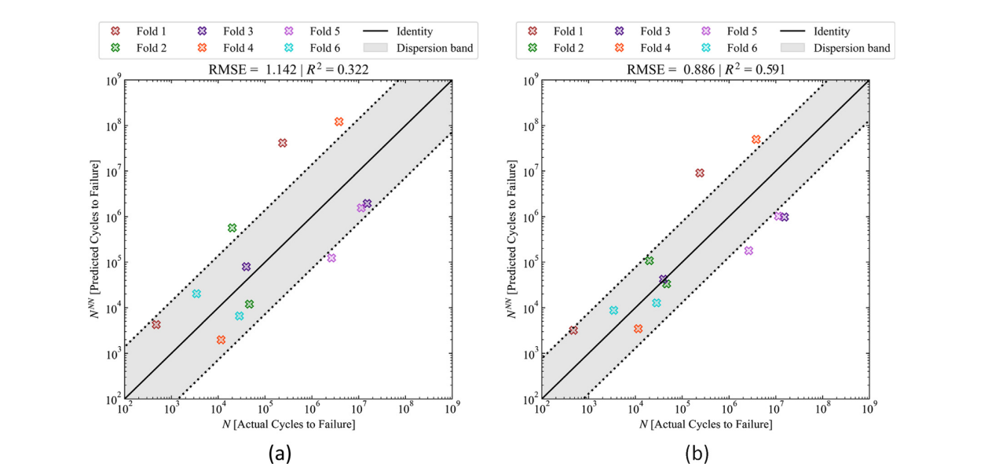
3. Results and Discussion – NN vs. PINN
W^{NN} = 0.985
W^{M} = 0.015
Accuracy of the PINN and NN frameworks evaluated through RMSE and R². Predicted vs. actual number of cycles for (a) NN and (b) PINN. Dispersion band evaluated at 68% confidence level.

Slide 18
4. Alternative inputs
Current approach models defects as spherical voids
More advanced preprocessing of the CT scans could provide more insightful input parameters about defect shape and orientation
Aspect Ratio
Sharpness
Variety of assumptions/exclusions could be treated as input variables
Build orientation is considered in sample production but not included in the modeling
Surface roughness is removed on lathe but never measured
Residual stress (HIP processing)
Process parameters/machine maintenance
More robust scanning for microstructure data
EBSD or XCT scans could provide microstructure data to be treated as an input
*Note this would significantly increase complexity

Slide 19
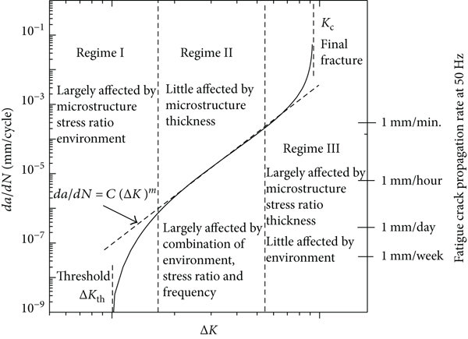
4. Alternative Outputs
Crack propagation rate (da/dN)
N with smaller variance (narrower band )
δK
N

Slide 20
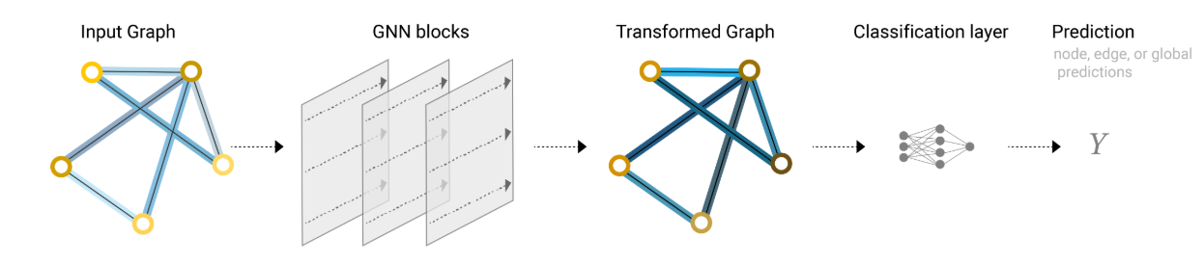
4. New/Additional ML Framework
Problem: current methods do not directly account for interdependencies of defects and their effect on failure
i.e., How does the overall distribution of defects contribute to the cycles to failure
Do more closely located defects produce a shorter fatigue life?
Solution: Graphical Neural Network (GNN)
‘Graphs’ represent information through nodes and edges to convey uniquely interconnected data
Directly assigning dependency to the inputs based on relative location (more robust)
Input Graph:
Nodes: defects (size, shape, location, etc.)
Edges: connections (distance, relative orientation, etc.)
Prediction
GNN predicted fatigue life (N^{GNN})

Slide 21
4. New/Additional Physical Model
Elastic-Plastic Fracture Mechanics : Plastic deformation near crack tip
J-integral, CTOD
Damage Mechanics Model : Material degradation as a continuum phenomenon
CZM
Continuum damage mechanics : Lemaitre Damage Model, Chaboche Damage Model
Micromechanical Damage Models : Gurson Model, Rice and Tracey Model, Kachanov-Rabotnov Model
XFEM : Discontinuous functions for cracks
Simulation for data

Slide 22

Questions?

Slide 23
Back Up Slides

Slide 24
Blank Slide

Slide 25
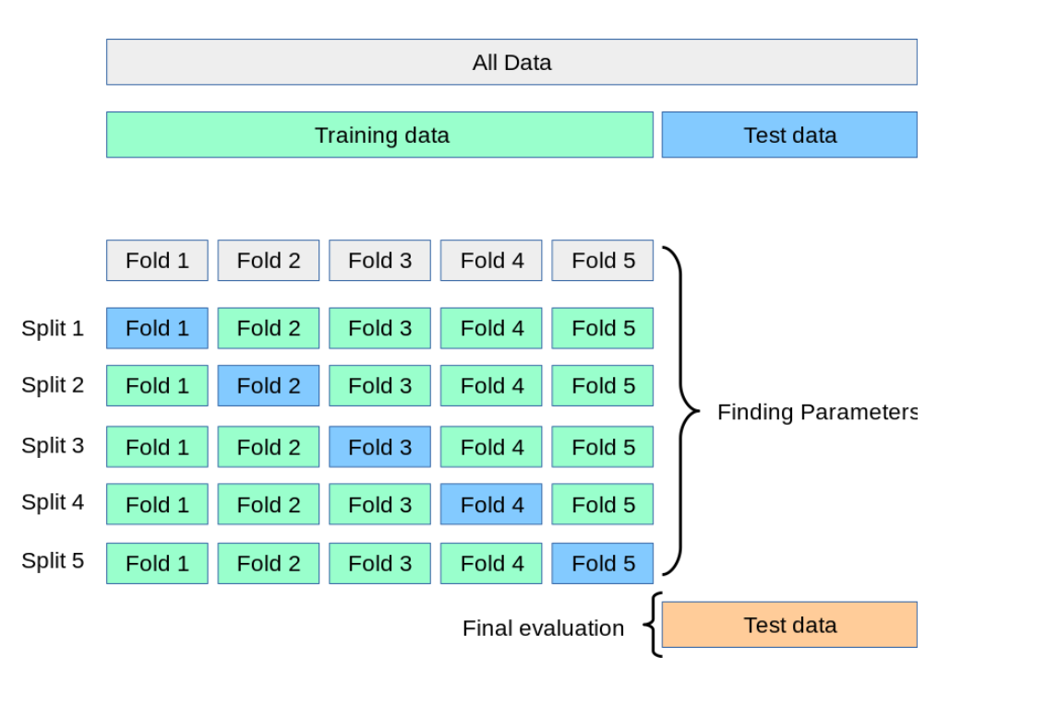
K-fold Validation

Slide 26
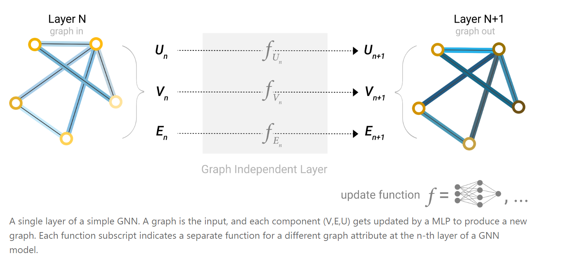
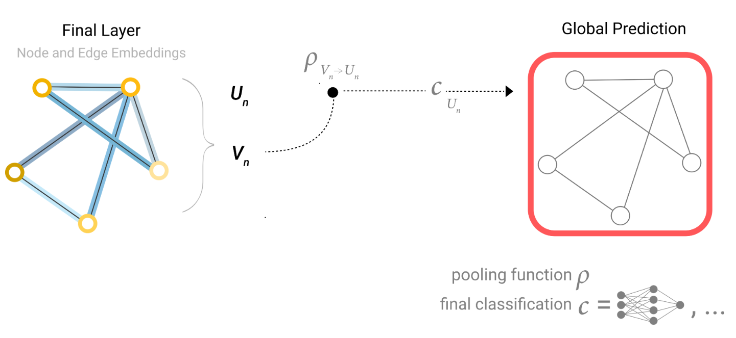
GNN Detail

Slide 27
Questions from Dr. Acar
Did the authors check training and test error, is there any over-training? Did they try different NN architectures? How are the weights of NN and physics-based losses decided?
6 fold cross validation implies 83.3% train and 16.7% test (may not be a large enough test dataset)
Weights for loss functions are arbitrarily decided. (“what worked the best”)
Is there any reasoning behind the Gaussian distribution assumption?
Central Limit Theorem: variability from many small uncertain independent variables tends toward gaussian
Smooth differentiable loss function with reasonable assumptions
Assuming the number of samples stays the same, which of your suggestions would work?
GNN could provide more robust solution without changing inputs or complexity of model (may not be fully accurate)
What are the mathematical challenges associated with defining da/dN (or N?) as the output parameter?
da/dN is just a number(value) at point, so we don’t expect any such issue. However, we acknowledge that it will depend a lot on how we are training and predicting. For example if we are predicting crack size (as a function of number of cycles) and if it is not continuous then this will give rise to mathematical issues.
Also, If the relationship is not continuous or exhibits jumps, the model could face difficulties in making accurate predictions, especially when using regression-based methods or NN models.
Why do you prefer GNN, rather than, for instance, CNN?
CNN works best for data organized in a grid like structure. While images act as inputs to describe the defects and its shape/location, this is not nearly as efficient as a graph.
Both local and global patterns can be captured through GNN (i.e., local: nodes/edges global: entire graph
Message passing in GNNs is well suited for complex interaction between nodes (cracks combining, separating, etc.)
Would you consider any error metrics other than R2?
Adjusted R2 could account for limited size of dataset (12) when considering a large number of inputs (13 node input layer)

